Slide 1



Deep Learning Design Patterns with Tensorflow 2.0
Computer Vision Workshop - Convolutional Neural Networks Version: Jan 2020
Repo: github.com/GoogleCloudPlatform/keras-idiomatic-programmer
twitter.com/andrewferlitsch

Slide 2
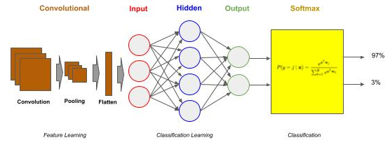
Convolutional Neural Networks
Convolutional Neural Networks (CNN)
Convolutional Neural Networks (CNN) are a type of neural network that can be viewed as consisting of two parts, a frontend and a backend. The backend is a deep neural network (DNN). The name convolutional neural network comes from the frontend, referred to as a convolutional layer(s). The frontend acts as a preprocessor.
The DNN backend does the "classification learning". The CNN frontend preprocesses the image data into a form which is computationally practical for the DNN to learn from. The CNN frontend does the "feature learning".

Slide 3
Convolutional Neural Networks - Classifier
CNN Classifier
Once we get to larger image sizes, the number of pixels for a DNN becomes computationally too expensive to be feasible. A 1MB image will have one million pixels. That would require an input vector of 1,000,000 elements. And let's assume that input layer has 1024 nodes. The number of weights to "update and learn" learn would be over a billion (1 million x 1024) at just the input layer!
Contrast this to the MNIST example where we had 784 pixels times 512 nodes on our input layer. That's 400,000 weights to learn, which is considerably smaller than 1 billion.

Slide 4
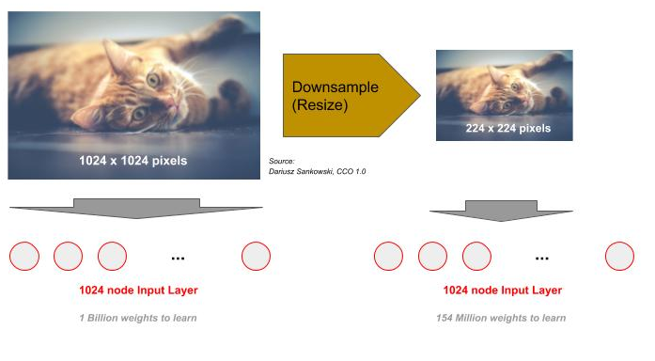
Convolutional Neural Networks - Resize
Downsampling (Resize)
One approach is to reduce the resolution of the image (downsampling). At some point if we reduce too far we lose the ability to distinguish clearly what's in the image - it becomes fuzzy and/or has artifacts. So, the first step is to reduce the resolution down to the level that we still have enough details. The common convention for everyday computer vision is around 224 x 224. We do this by resizing. Even at this lower resolution and three channels for color images, and an input layer of 1024 nodes, we still have 154 million weights to "update and learn" (224 x 224 x 3 x 1024).

Slide 5
Convolutional Neural Networks - Layers
Convolutional Layers
Training on real-world images was out of reach with neural networks until the discovery of using convolutional layers. To begin with, a convolutional layer is a frontend to a neural network, which transforms the images from a high dimensional pixel based image to a substantially lower dimensionality feature based image.
The substantially lower dimensionality features can then be inputted as the input vector to a DNN.
A convolutional frontend is a frontend between the image data and the DNN.

Slide 6
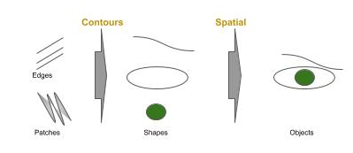
CNN - Feature Detection
Feature Detection (Human)
For higher resolution and more complex images, we do recognition by detecting and classifying features instead of classifying pixel positions.
Visualize an image, and ask yourself what makes you recognize what's there? Go beyond the high level of asking is that a person, a cat, a building, but ask why can you seperate in a picture a person standing in front of a building, or a person holding a cat.
Your eyes are recognizing low-level features, such as edges, blurs, contrast, etc. These low-level features are built up into contours and then spatial relationships. Suddenly, the eye/brain have the ability to recognize nose, ears, eyes - that's a cat face, that's a human face.

Slide 7
CNN - Feature Detection
Feature Detection (Convolution)
A convolutional layer performs the task of feature detection within an image. Each convolution consists of a set of filters. These filters are NxM matrices of values that are used to detect the likely presence (detection) of a feature.
They are slid across the image, and at each location a comparison is made between the filter and the pixel values at that location. That comparison is done with a matrix dot product.
What's important, is the result of this operation will generate a value that indicates how strongly the feature was detected at that location in the image. For example, a value of 4 would indicate a stronger presence of the feature than the value of 1.

Slide 8
Convolutional Neural Networks - Filters
Filters are Learned
Prior to neural networks, imaging scientists hand designed these filters. Today, the filters along with the weights in the neural network are "learned".
In a convolutional layer, one specifies the size of the filter and the number of filters. Typical filter sizes are 3x3 and 5x5, with 3x3 the most common.
The number of filters varies more, but they are typically multiples of 16, such as 16, 32 or 64 are the most common in shallow networks, and 256, 512 and 1024 in deep convolutional neural networks.

Slide 9
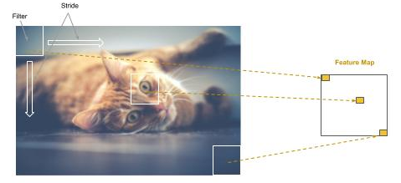
CNN - Feature Maps
Feature Maps
Additionally, one specifies a stride. The stride is the rate that the filter is slid across the image. For example, if the stride is one, the filter advances one pixel at a time, thus the filter would partially overlap with the previous step in a 3x3 filter (and consequently so would a stride of 2). In a stride of 3, there would be no overlap. Most common practice is to use strides of 1 and 2. Each filter that is "learned" produces a feature map, which is a mapping (where) on how strongly the feature is detected in the image.

Slide 10
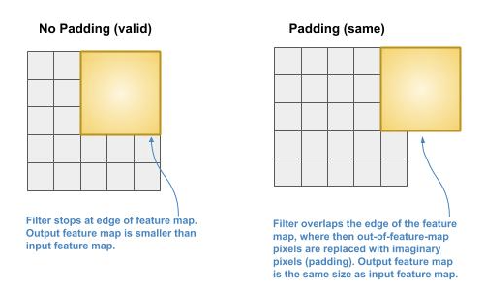
CNN - Padding
Padding
The filter can either stop when it gets to the edge of the image, or continue until the last column is covered.
The former case is called no padding. The later case is called padding.

Slide 11
CNN - Filters & Strides
Filters and Strides
When there are multiple convolutional layers, the common practice is to keep the same or increase the number of filters on deeper layers, and to use stride of 1 on the first layer and 2 on deeper layers.
The increase in filters provides the means to go from coarse detection of features to more detailed detection within coarse features, while the increase in stride offsets the increase in size of retained data, which is also referred to as feature pooling.
More Filters => More Data
Bigger Strides => Less Data

Slide 12
CNN - Filters & Strides
Downsampling
There are two types of downsampling:
pooling -- a fixed algorithm is used to downsample the size of the image data.
feature pooling -- the best downsampling algorithm for the specific dataset is “learned”.

Slide 13
Convolutional Neural Networks - Pooling
Pooling
Even though each feature map generated typically is equal or less in size of the image, because we generate multiple feature maps (e.g., 16), the total data size has gone up. The next step is to reduce the total amount of data, while retaining the features detected and corresponding spatial relationship between the detected features.
This step is referred to as pooling. Pooling is the same as downsampling (or sub-sampling); whereby the feature maps are resized to a smaller dimension using either max (downsampling) or mean (sub-sampling) pixel average within the feature map.

Slide 14
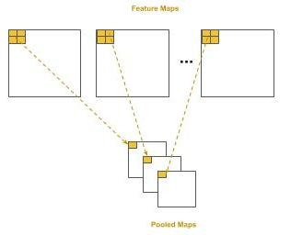
Convolutional Neural Networks - Pooling
Pooling
In pooling, we set the size of the area to pool as a NxM matrix as well as a stride. The common practice is a 2x2 pool size with a stride of 2. This will result in a 75% reduction in pixel data, while still preserving enough resolution that the detected features are not lost through pooling.

Slide 15
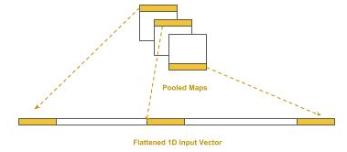
Convolutional Neural Networks - Flattening
Flattening
Deep neural networks take vectors as input, that’s one dimensional arrays of numbers. In the case of the pooled maps, we have a list (plurality) of 2D matrices, so we need to transform these into a single 1D vector which then becomes the input vector to the DNN.
This process is called flattening; that is, we flatten the list of 2D matrices into a single 1D vector. We start with the first row of the first pooled map as the beginning of the 1D vector. We then take the 2nd row and append it to the end, and then the 3rd row, and so forth. We then proceed to the second pooled map and do the same process, continuously appending each row, until we’ve completed the last pooled map. As long as we follow the same sequencing through pooled maps, the spatial relationship between detected features will be maintained across images for training and inference (prediction).

Slide 16
CNN - Basic Sequential Model
Basic Sequential CNN - Conv2D
We will design a basic sequential model in two parts, the convolutional frontend and the DNN backend. We start by adding a convolutional layer of 16 filters as the first layer using the Conv2D class object.
The size of each filter will be a 3x3, which is specified by the parameter kernel_size and a stride of 2 by the parameter strides. Note that for strides a tuple of (2, 2) is specified instead of a single value 2. The first digit is the horizontal stride (across) and the second digit is the vertical stride (down). It’s a common convention for stride that the horizontal and vertical are the same; therefore one commonly says a “stride of 2” instead of “a 2x2 stride”.
We pick an input size for our images. We like to reduce the size to as small as possible without losing detection of the features. In this case, we choose 128 x 128 (grayscale). The Conv2D class always requires specifying the number of channels, instead of defaulting to one for grayscale; we specified it as (128, 128, 1) instead of (128, 128).
from tensorflow.keras.models import Sequential from tensorflow.keras.layers import Dense, ReLU, Activation, Conv2D, MaxPooling2D, Flatten model = Sequential() # Create a convolutional layer with 16 3x3 filters and stride of two as the input layer model.add(Conv2D(16, kernel_size=(3, 3), strides=(2, 2), padding="same", input_shape=(128,128,1)))

Slide 17
CNN - Basic Sequential Model
Basic Sequential CNN - MaxPooling2D - Flatten
The output from the convolution layer is passed through a rectified linear unit activation, which is then passed to the max pooling layer, using the MaxPooling2D class object. The size of the pooling region will be 2x2, specified by the parameter pool_size, with a stride of 2 by the parameter strides.
The pooling layer will reduce the feature maps by 75% into pooled feature maps. The pooled feature maps are then flattened, using the Flatten class object, into a 1D vector for input into the DNN. We will glance over the parameter padding.In almost all cases, you will use the value same; it’s just that the default is valid and therefore you need to explicitly add it.
# Pass the output (feature maps) from the input layer (convolution) through a rectified linear unit activation # function. model.add(ReLU()) # Add a pooling layer to max pool (downsample) the feature maps into smaller pooled feature maps model.add(MaxPooling2D(pool_size=(2, 2), strides=(2, 2))) # Add a flattening layer to flatten the pooled feature maps to a 1D input vector for the DNN classifier model.add(Flatten())

Slide 18
CNN - Basic Sequential Model
Basic Sequential CNN - Attaching the DNN Classifier
Finally, we attach the DNN classifier. In this example, we assume the classifier will be trained for recognizing 26 handwritten lowercase (or hand-signed) characters of the English alphabet.
# Add the input layer for the DNN, which is connected to the flattening layer of the convolutional frontend model.add(Dense(512)) model.add(ReLU()) # Add the output layer for classifying the 26 hand signed letters model.add(Dense(26)) model.add(Activation('softmax')) # Use the Categorical Cross Entropy loss function for a Multi-Class Classifier. model.compile(loss='categorical_crossentropy', optimizer='adam', metrics=['accuracy'])

Slide 19
CNN - Basic Sequential Model
Basic Sequential CNN - Model Summary
Feature Map Size (e.g., 64 x 64)
Layer (type) Output Shape Param # ================================================================= conv2d_1 (Conv2D) (None, 64, 64, 16) 160 _________________________________________________________________ re_lu_1 (ReLU) (None, 64, 64, 16) 0 _________________________________________________________________ max_pooling2d_1 (MaxPooling2 (None, 32, 32, 16) 0 _________________________________________________________________ flatten_1 (Flatten) (None, 16384) 0 _________________________________________________________________ dense_1 (Dense) (None, 512) 8389120 _________________________________________________________________ re_lu_2 (ReLU) (None, 512) 0 _________________________________________________________________ dense_2 (Dense) (None, 26) 13338 _________________________________________________________________ activation_1 (Activation) (None, 26) 0 ================================================================= Total params: 8,402,618 Trainable params: 8,402,618 Non-trainable params: 0
Number of Filters
No Training Parameters
16384 x 512 (weights) + 512 (bias) = 8,389,120
512 * 26 (weights) + 26 (bias) = 13,338
Vector Length of Flattened Feature Maps

Slide 20
CNN - Basic Sequential Model
Basic Sequential CNN - Functional API Approach
In the Functional API approach we separately define each layer, starting with the input vector and proceed to the output layer. At each layer we use polymorphism to invoke the instantiated class (layer) object as a callable and pass in the object of the previous layer to connect it to.
from tensorflow.keras import Input, Model from tensorflow.keras.layers import Dense from tensorflow.keras.layers import Conv2D, MaxPooling2D, Flatten # Create the input vector (128 x 128). inputs = Input(shape=(128, 128, 1)) layer = Conv2D(16, kernel_size=(3, 3), strides=(2, 2), padding="same", activation='relu')(inputs) layer = MaxPooling2D(pool_size=(2, 2), strides=(2, 2))(layer) layer = Flatten()(layer) layer = Dense(512, activation='relu')(layer) output = Dense(26, activation='softmax')(layer) # Now let's create the neural network, specifying the input layer and output layer. model = Model(inputs, output)
#1 - Start with inputs
#2 - attach layers
#3- Last Layer is the output
#4 Put it together: inputs => output

Slide 21
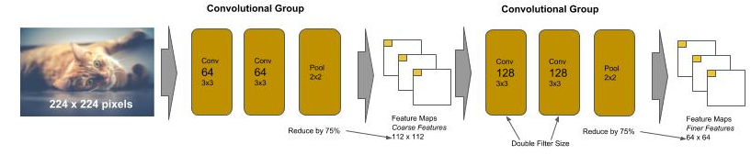
VGG
VGG Networks
The VGG type of CNN was designed by the Visual Geometry Group at Oxford. It was designed to compete in the international ImageNet competition for image recognition for 1000 classes of images. The VGGNet in the 2014 contest took first place on image location task and second place on the image classification task.
It is designed using a handful of principles that are easy to learn. The convolutional frontend consists of a sequence of pairs (and later triples) of convolutions of the same size, followed by a max pooling. The max pooling layer downsamples the generated feature maps by 75% and the next pair (or triple) of convolutional layers than doubles the number of learned filters. The principle behind the convolution design was that the early layers learn coarse features and subsequent layers, by increasing the filters, learn finer and finer features, and the max pooling is used between the layers to minimize growth in size (and subsequently parameters to learn) of the feature maps. Finally, the DNN backend consists of two identical sized dense hidden layers of 4096 nodes each, and a final dense output layer of 1000 nodes for classification.

Slide 22
VGG16
VGG16 - Sequential Flow We will code a VGG16 in two coding styles. The first in a sequential flow.
from keras import Sequential from keras.layers import Conv2D, MaxPooling2D, Flatten, Dense model = Sequential() # First convolutional block model.add(Conv2D(64, (3, 3), strides=(1, 1), padding="same", activation="relu", input_shape=(224, 224, 3))) model.add(Conv2D(64, (3, 3), strides=(1, 1), padding="same", activation="relu")) model.add(MaxPooling2D((2, 2), strides=(2, 2))) # reduce feature maps by 75% # Second convolutional block - double the number of filters model.add(Conv2D(128, (3, 3), strides=(1, 1), padding="same", activation="relu")) model.add(Conv2D(128, (3, 3), strides=(1, 1), padding="same", activation="relu")) model.add(MaxPooling2D((2, 2), strides=(2, 2))) # reduce feature maps by 75% ### REMOVED Lines for Brevity # DNN Backend model.add(Flatten()) model.add(Dense(4096, activation='relu')) model.add(Dense(4096, activation='relu')) # ...

Slide 23
VGG16
VGG16 - Procedurally (Reuse)
Let’s code the same using a procedural “reuse” style. In this example we created a procedure (function) call conv_block() which builds the convolutional blocks, and takes as parameters the number of layers in the block (2 or 3), and number of filters (64, 128, 256 or 512). Note that we kept the first convolutional layer outside of the conv_block. The first layer needs the input_shape parameter. We could have coded this as a flag to conv_block, but since it would only occur one time, then it’s not reuse. So we inline it instead.
from keras import Sequential from keras.layers import Conv2D, MaxPooling2D, Flatten, Dense def conv_block(n_layers, n_filters): for n in range(n_layers): model.add(Conv2D(n_filters, (3, 3), strides=(1, 1), padding="same", activation="relu")) model.add(MaxPooling2D(2, strides=2)) # Convolutional Frontend model = Sequential() model.add(Conv2D(64, (3, 3), strides=(1, 1), padding="same", activation="relu", input_shape=(224, 224, 3))) conv_block(1, 64) conv_block(2, 128) conv_block(3, 256) conv_block(3, 512) conv_block(3, 512) # ...

Slide 24
Residual Convolutional Networks (ResNet)
ResNet Networks
The ResNet type of CNN was designed by Microsoft Research. It was designed to compete in the international ImageNet competition. The ResNet in the 2015 contest took first place in all categories for ImageNet and COCO competition.
ResNet, and other architectures within this class, use different layer to layer connection patterns. The pattern we’ve discussed so far (ConvNet and VGG) use the fully connected layer to layer pattern.
ResNet 34 introduced a new block layer and layer connection pattern, residual blocks and identity connection, respectively.
The residual block in ResNet 34 consists of blocks of two identical convolutional layers without a pooling layer.
Each block has an identity connection which creates a parallel path between the input of the residual block and its output.
Like VGG, each successive block doubles the number of filters. Pooling is done at the end of the sequence of blocks.

Slide 25
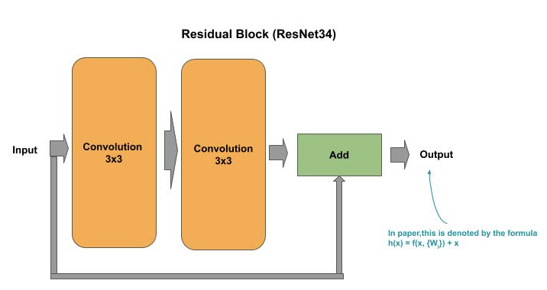
Residual Convolutional Networks (ResNet)
ResNet Networks
One of the problems with neural networks is that as we add deeper layers (under the presumption of increasing accuracy) their performance can degrade. That is, it can get worse not better.
Residual blocks allow neural networks to be built with deeper layers without a degradation in performance.

Slide 26
ResNet - Residual Block
Residual Blocks
Below shows how a residual block can be coded in TF.Keras using the Functional API method. The variable x represents the output of a layer, which is the input to the next layer. At the beginning of the block, we retain a copy of the previous block/layer output as the variable shortcut. We then pass the previous block/layer output (x) through two convolutional layers, each time taking the output from the previous layer as input into the next layer. Finally, the last output from the block (retained in the variable x) is added (matrix addition) with the original value of x (shortcut). This is the identity link.
shortcut = x x = layers.Conv2D(64, kernel_size=(3, 3), strides=(1, 1), padding='same')(x) x = layers.ReLU()(x) x = layers.Conv2D(64, kernel_size=(3, 3), strides=(1, 1), padding='same')(x) x = layers.ReLU()(x) x = layers.Add()([shortcut, x])

Slide 27
ResNet - Convolutional Block Connector
Convolutional Block Connector
Unlike VGG though, there is no pooling layer between the groups that would reduce the size of the feature maps. Now, if we connected these groups directly with each other, we have a problem. That is, the input to the next group has the shape based on the previous group’s filter size (let’s call it X). The next group by doubling the filters will cause the output of that residual group to be double in size (let’s call it 2X). The identity link would attempt to add the input matrix (X) and the output matrix (2X). Yeaks, we get an error, indicating we can’t broadcast (for add operation) matrices of different sizes.
For ResNet, this is solved by adding a convolutional block between each “doubling” group of residual blocks. The convolutional block doubles the filters to reshape the size and doubles the stride to reduce the size by 75%.
# First Residual Block Group of 64 filters for _ in range(3): x = residual_block(64, x) # Double the size of filters and reduce feature maps by 75% (strides=2, 2) to fit the next Residual Group x = conv_block(128, x)

Slide 28
ResNet - ReUse Procedures
Residual and Convolutional Blocks as Reuse Procedures
def residual_block(n_filters, x): """ Create a Residual Block of Convolutions n_filters: number of filters x : input into the block """ shortcut = x x = layers.Conv2D(n_filters, (3, 3), strides=(1, 1), padding="same", activation="relu")(x) x = layers.Conv2D(n_filters, (3, 3), strides=(1, 1), padding="same", activation="relu")(x) x = layers.Add()([shortcut, x]) return x def conv_block(n_filters, x): """ Create Block of Convolutions without Pooling n_filters: number of filters x : input into the block """ x = layers.Conv2D(n_filters, (3, 3), strides=(2, 2), padding="same", activation="relu")(x) x = layers.Conv2D(n_filters, (3, 3), strides=(2, 2), padding="same", activation="relu")(x) return x

Slide 29
ResNet - Pooling/Flattening
Global Average Pooling
The output of the last residual block group is passed to a pooling and flattening layer (GlobalAveragePooling2D), which is then passed to a single Dense layer of 1000 nodes (number of classes).
In modern convolutional architectures, the DNN backend is now a single dense layer for the final classification. In other words, except for the last step of predicting the class (label), classification is now pushed to the frontend in the last convolutional blocks.
# Now Pool at the end of all the convolutional residual blocks x = layers.GlobalAveragePooling2D()(x) # Final Dense Outputting Layer for 1000 outputs outputs = layers.Dense(1000)(x) model = Model(inputs, outputs)

Slide 30
ResNet - Computational Faster
Computational Complexity
Let’s now run model.summary(). We see that the total number of parameters to learn is 21 million. This is in contrast of the VGG16 which has 138 million parameters. So the ResNet architecture is 6 times computationally faster. This reduction is mostly achieved by the construction of the residual blocks. Notice how the DNN backend is just a single output Dense layer. In effect, there is no backend. The first residual block groups act as the CNN frontend doing the feature detection, while the later residual blocks perform the classification. In doing so, unlike VGG, there was no need for several fully connected dense layers, which would have substantially increased the number of parameters.
Another advantage is the identity link, which provided the ability to add deeper layers, without degradation, for higher accuracy.

Slide 31
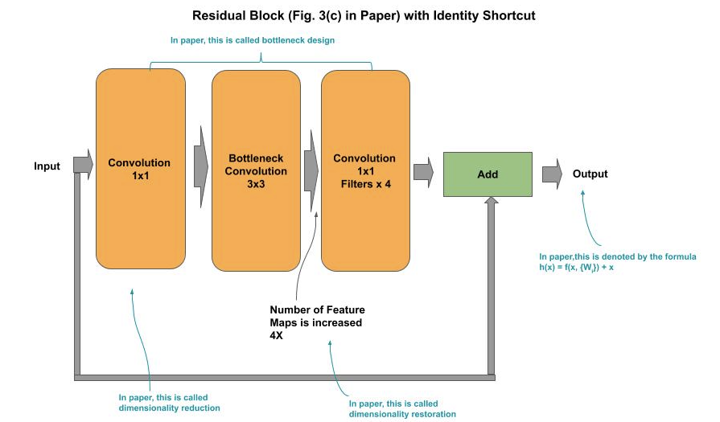
ResNet50 - Bottleneck Residual Block
Bottleneck Residual Block
ResNet50 introduced a variation of the residual block referred to as the bottleneck residual block. In this version, the group of two 3x3 convolution layers are replaced by a group of 1x1, then 3x3, and then 1x1 convolution layer. The 1x1 convolutions perform a dimension reduction reducing the computational complexity, and the last convolutional restores the dimensionality increasing the number of filters by a factor of 4. The bottleneck residual group allows for deeper neural networks, without degradation, and further reduction in computational complexity.

Slide 32
ResNet50 - Bottleneck Residual Block
Bottleneck Residual Block
Below is a code snippet for writing a bottleneck block as a reusable function:
def bottleneck_block(n_filters, x): """ Create a Bottleneck Residual Block of Convolutions n_filters: number of filters x : input into the block """ shortcut = x x = layers.Conv2D(n_filters, (1, 1), strides=(1, 1), padding="same", activation="relu")(x) x = layers.Conv2D(n_filters, (3, 3), strides=(1, 1), padding="same", activation="relu")(x) x = layers.Conv2D(n_filters * 4, (1, 1), strides=(1, 1), padding="same", activation="relu")(x) x = layers.Add()([shortcut, x]) return x

Slide 33
Batch Normalization
Batch Normalization
Another problem with adding deeper layers in a neural network is the vanishing gradient problem. This is about the computer hardware. During training (process of backward propagation and gradient descent), at each layer the weights are being multiplied by very small numbers, specifically numbers less than 1. As you know, two numbers less than one multiplied together make an even smaller number. When these tiny values are propagated through deeper layers they continuously get smaller. At some point, the computer hardware can’t represent the value anymore - and hence, the vanishing gradient.
The problem is further exacerbated if we try to use half precision floats (16 bit float) for the matrix operations versus single precision (32 bit float). The advantage of the former is that the weights (and data) are stored in half the amount of space and using a general rule of thumb by reducing the computational size in half, we can execute 4 times as many instructions per compute cycle. The problem of course is that with even smaller precision, we will encounter the vanishing gradient even sooner.

Slide 34
Batch Normalization
Batch Normalization
Batch normalization is a technique applied to the output of a layer (before or after the activation function).It normalizes the shift in the weights as they are being trained. This has several advantages, it smoothes out (across a batch) the amount of change, thus slowing down the possibility of getting a number so small that it can’t be represented by the hardware. Additionally, by narrowing the amount of shift between the weights, convergence can happen sooner using a higher learning rate and reducing the overall amount of training time. Batch normalization is added to a layer in TF.Keras with the BatchNormalization() class.
from keras import Sequential from keras.layers import Conv2D, ReLU, BatchNormalization, Flatten, Dense model = Sequential() model.add(Conv2D(64, (3, 3), strides=(1, 1), padding='same', input_shape=(128, 128, 3))) # Add a batch normalization (when training) to the output before the activation function model.add(BatchNormalization()) model.add(ReLU()) model.add(Flatten()) model.add(Dense(4096)) model.add(ReLU()) # Add a batch normalization (when training) to the output after the activation function model.add(BatchNormalization())

Slide 35
Convolutional Neural Networks - Lab Exercise #2
Optional Code Lab - Get Familiar with Convolutional Neural Networks (CNN)
Deep Learning Design Patterns - Workshop - Chapter II.ipynb
https://bit.ly/2URAYa6

